Slide 1
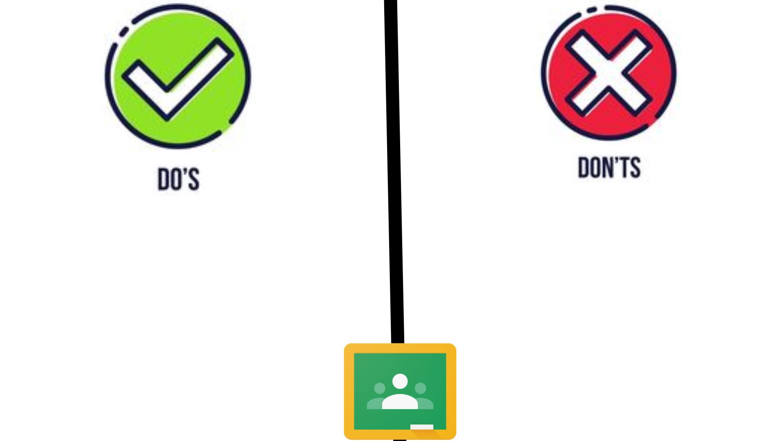
Google classroom Norms
Drag each statement from the sides to the proper place on the board. Are each of the statements things you should do or not do on Google Classroom?

Slide 2
Before you post
Before you Post
Drag each question below next to the appropriate letter.
Before you post

Slide 3
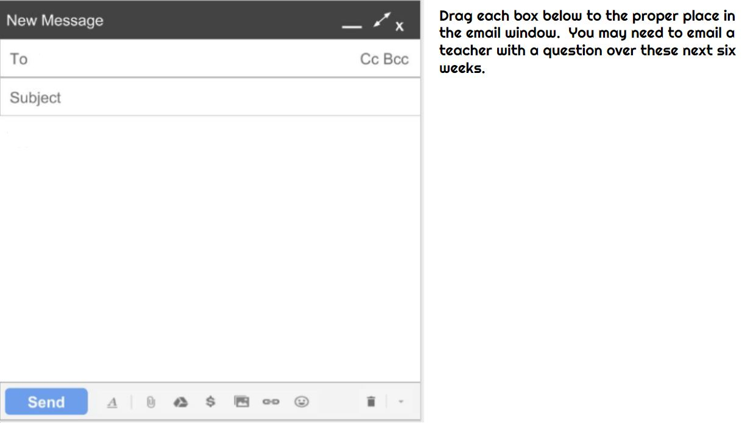
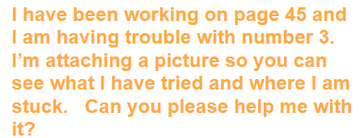
Create a email

